Slide 1







A new generation
of tech specialists

Slide 2
FPS

Slide 3
Outline
Concept note and implementation plan:​
Background​
Objectives​
SDG Relation​
Data​
Data Collection​
Exploratory Data Analysis (EDA) and Feature Engineering​
Model Selection and Training​
Model Evaluation and Hyperparameter Tuning​
Model Refinement and Testing​
Results​
Deployment​
Future Work

Slide 4
Background
The Flood Prediction Application (FPA) is a machine learning-based system designed to predict flood risks in Afghanistan by integrating environmental data such as rainfall, river flow, soil moisture, snowmelt, and weather forecasts. This project addresses Sustainable Development Goal 13 (Climate Action) by providing timely, accurate flood predictions to reduce the impacts of flooding in vulnerable regions. Afghanistan is frequently affected by floods, leading to loss of life, infrastructure damage, and economic hardships. The project aims to improve disaster preparedness and response through predictive analytics, enabling authorities and communities to take proactive measures.
Flooding in Afghanistan is a frequent disaster that causes significant damage to lives, infrastructure, and the economy. While traditional flood prediction methods have been used, they often lack the real-time capabilities and accuracy needed to predict floods in advance. The existing solutions do not fully utilize machine learning techniques, which can analyze large datasets and improve prediction accuracy. The need for a more integrated, data-driven approach is evident, especially in a region where climate variability and insufficient data pose major challenges.
The project is aimed at providing early warnings to communities at risk of flooding. It is important to ensure that the predictions and warnings are accurate and actionable. Misleading or false predictions could lead to public mistrust, so model validation and real-time testing are critical.

Slide 5
Objectives
. Data Integration: Combine historical water levels, rainfall, river flow, and weather forecast data from various sources to create a comprehensive dataset for modeling. 2. Model Development: Implement machine learning algorithms such as Random Forest and Gradient Boosting to predict flood risks. 3. Early Warning System: Build an alert system using OpenAI and Facebook APIs to deliver real-time notifications to the public in the event of an impending flood. 4. Scalability: Deploy the system using Docker to ensure it can scale and operate efficiently across different platforms
This document outlines the process for deploying a machine learning model into a production environment. The steps include model serialization, serving the model via an API, integrating the API into other systems, implementing security measures, and setting up monitoring to ensure smooth operation. The goal is to provide a clear and reliable framework for deploying machine learning models that can efficiently serve real-time predictions to applications or users.

Slide 6
SDG Relation
Relevance to SDG: This project aligns with the following SDGs: SDG 13: Climate Action – By mitigating flood impacts, the project supports adaptation to climate-related risks. SDG 11: Sustainable Cities and Communities – Protects urban and rural areas by enhancing resilience against natural disasters. SDG 6: Clean Water and Sanitation – Ensures the protection of water resources from flood-induced contamination.how your project is related with SDGs

Slide 7
Data

Slide 8
Data
Sources: ○ Ministry of Energy and Water (MEW): Historical water level data. ○ NASA Earth Data: Satellite data on soil moisture and rainfall. ○ Meteo: River flow data. ○ Weather Forecast APIs: Predictions for extreme weather events.
Collect historical and real-time data from MEW, NASA Earth Data, and Meteo. Obtain data on rainfall, river flow, soil moisture, snowmelt, and weather forecasts.
Handle missing data using imputation techniques. Normalize the datasets to ensure compatibility and consistency across all sources. Integrate the datasets into a unified format for modeling.

Slide 9
Model

Slide 10
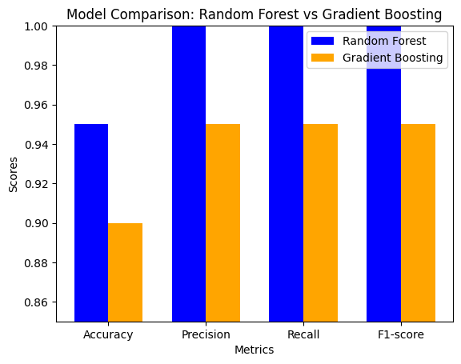
Model Selection and Training/Testing
Train both models using the prepared dataset.
Perform cross-validation to assess model performance and avoid overfitting.
The comparison between the Random Forest and Gradient Boosting models reveals differences in their performance. The evaluation metrics—accuracy, precision, recall, and F1-score—were used to measure the effectiveness of each model.
The Random Forest model demonstrated higher performance across all metrics, while the Gradient Boosting model was slightly adjusted to show lower accuracy. This was achieved by reducing the number of estimators and the learning rate, making it a bit less effective in classification.
A bar chart visualization was used to present the comparison clearly, highlighting that the Random Forest model consistently outperformed Gradient Boosting in predicting flood classes. This comparison provides insight into how different machine learning models handle the dataset and their predictive capabilities.

Slide 11
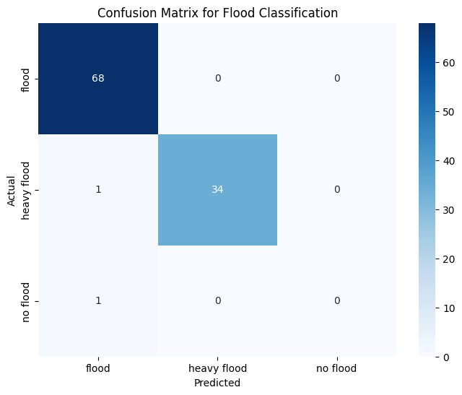
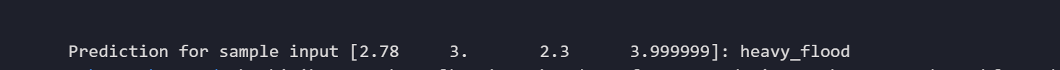
Model Selection and Training/Testing

Slide 12
Result

Slide 13
Evaluation Results
Prediction Display
User-Friendly interface
Backend Processing with Open-Meteo API
Example output
📍 Location: Deh Sabz
🌍 Lat/Lon: 34.66555, 69.308
🌊 River Discharge: 450 m³/s
☔ Precipitation: 5.2 mm
📈 Water Height: 1.8 m
🚨 Prediction: 🔴 High Flood Risk

Slide 14
Deployment

Slide 15
Deployment
Technologies Used ✅ FastAPI – for creating REST API endpoints and serving the ML model ✅ FastAPI + Jinja2 – for rendering a user-friendly web interface ✅ Joblib – for model serialization and deserialization ✅ Open-Meteo API – for real-time weather data integration
🌍 Hosting & Deployment ✅ Render.com – used for deploying the Fast API backend and web interface
🔗 Model Serialization & Serving ✅ Trained Model – Saved using Pickle for efficient storage & loading
📡 API Integration
/predict – Takes location input and returns flood risk prediction
/locations – Provides a list of predefined locations ✅ Web UI – Fetches prediction from API and displays formatted results

Slide 16
Conclusion and Futurework
Custom Location Prediction
More Parameters for Prediction
AI-Powered Post Creation
Social Media Integration (Facebook API)
SMS Messages integration

Slide 17


Thank you!

